Slide 1



Crime Data Analysis
By
Machavarapu Salman Raju
17th Feb 2024

Slide 2
Introduction
Chicago's crime rates fluctuate, particularly in violent crimes such as homicides and shootings.
Police implement strategies like increased patrols and community engagement to combat crime effectively.
Community involvement in crime prevention programs is crucial to address underlying social issues.
Chicago Police Department releases regular crime statistics, aiding analysis by researchers and policymakers.
Controversies surrounding CPD include allegations of misconduct, racial profiling, and excessive use of force.

Slide 3
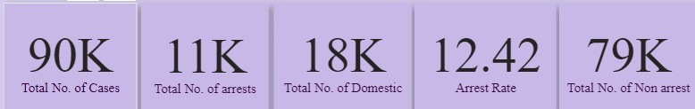
Overview
In 2022, Chicago reported approximately 89,916 total cases of crime across various categories.
Despite the high number of cases, there were only 11,000 arrests made by law enforcement.
Domestic cases accounted for a significant portion, with approximately 18,000 incidents reported.
The arrest rate stood at 12.42%, indicating that only a fraction of reported crimes resulted in arrests.
The remaining cases, totaling a substantial number, were classified as non-arrest incidents, warranting further examination.

Slide 4

Methodologies:
Data Import: Begin by importing raw data into Power BI from various sources such as Excel, CSV, or databases.
Data Cleaning: Utilize Power Query Editor to clean and transform data, including handling missing values, removing duplicates, and formatting data types.
Data Modeling: Design a data model by creating relationships between different tables, ensuring data integrity and accuracy.
Report Design: Develop visually appealing and intuitive reports using Power BI's drag-and-drop interface.
Visualization Selection: Choose appropriate visualizations such as bar charts, line charts, and maps to effectively convey insights.
Filtering and Slicing: Implement filters and slicers to enable users to interact with the data dynamically, allowing for deeper analysis.
Report Publishing: Share reports securely with stakeholders by publishing them to the Power BI Service or embedding them in other applications.

Slide 5
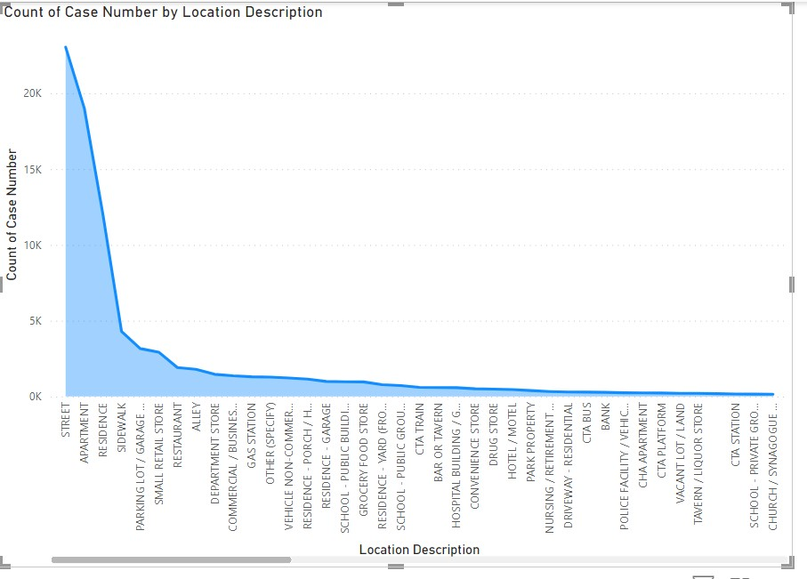
Analysis of Objective Questions
Locations Vs Crimes:
These are the locations a greater number of crimes are occur those are higher than expected. Here the graph shows the higher crimes.
Location Description | Count of Case Number
STREET | 23028
APARTMENT | 19019
RESIDENCE | 12018
SIDEWALK | 4302
PARKING LOT / GARAGE (NON-RESIDENTIAL) | 3166
SMALL RETAIL STORE | 2929
RESTAURANT | 1914
ALLEY | 1799
DEPARTMENT STORE | 1467
COMMERCIAL / BUSINESS OFFICE | 1372
GAS STATION | 1306
OTHER (SPECIFY) | 1279
VEHICLE NON-COMMERCIAL | 1223
RESIDENCE - PORCH / HALLWAY | 1150

Slide 6
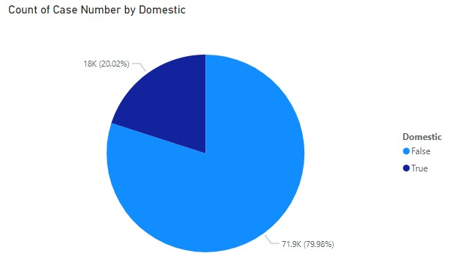
Domestic crimes Vs Non-Domestic Crimes:
Here is the ration Between Domestic related crimes to other types of crimes nearly 1:4
Below pie chart represents the ratio of domestic-related crimes to other types of
crimes to understand the prevalence of
domestic incidents.

Slide 7
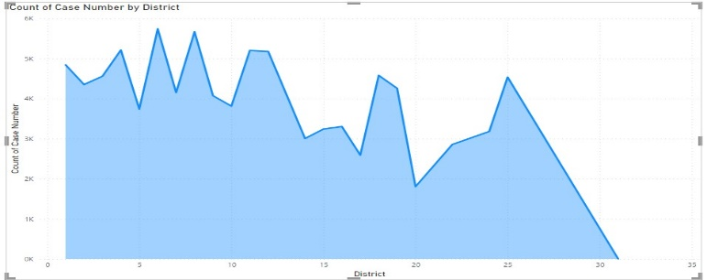
Insights from Subjective Questions
Districts Vs Crimes:
District 6: Recorded highest cases, totaling 5741 incidents.
District 8: Close behind with 5670 reported cases.
District 4: Follows closely with 5213 documented incidents.
District 11: Reported 5199 cases, fourth highest among districts.
District 12: Rounds up top five with 5177 recorded incidents.

Slide 8
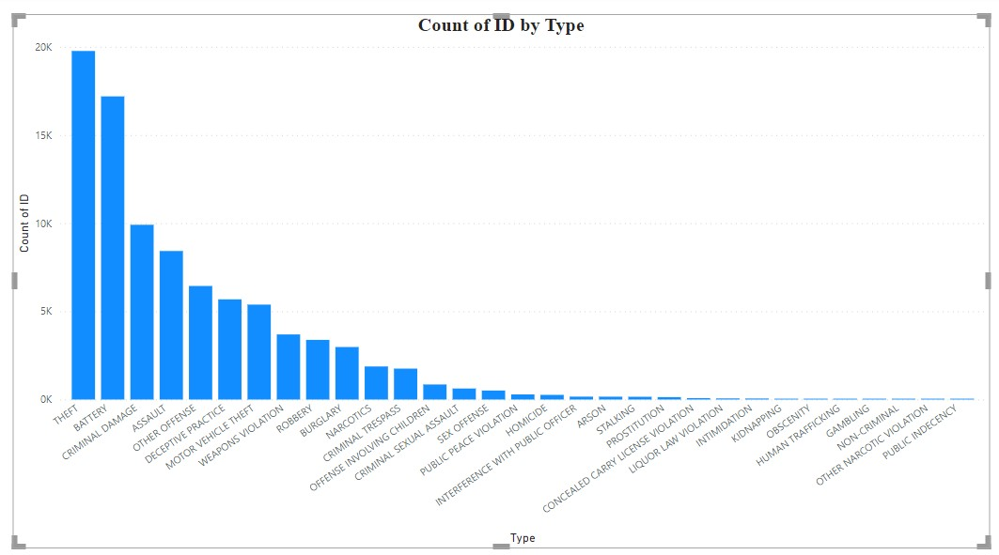
Crimes as per Type of crime:
Based on the provided data showing the count of each crime type, here is the assessment of the frequency of each crime type to identify the most prevalent crimes occurring in the area:
1. THEFT: 19,766 cases
2. BATTERY: 17,190 cases
3. CRIMINAL DAMAGE: 9,910 cases
4. ASSAULT: 8,423 cases
5. OTHER OFFENSE: 6,440 cases
6. DECEPTIVE PRACTICE: 5,682 cases
7. MOTOR VEHICLE THEFT: 5,383 cases
8. WEAPONS VIOLATION: 3,692 cases
9. ROBBERY: 3,384 cases
BURGLARY: 2,978 cases
From the above data, it's evident that the most prevalent crimes occurring in the area are THEFT followed by BATTERY, CRIMINAL DAMAGE, and ASSAULT. These crimes have the highest counts and therefore represent the most common types of criminal activities in the area.

Slide 9
Strategic Recommendations
Detailed analysis uncovers crime patterns: types, districts, FBI codes, descriptions, and street names.
Specific insights inform strategic resource allocation for effective policing.
Generalized approach targets high-risk areas to enhance overall security.
Data-driven strategies crucial for proactive crime prevention measures.
Visualizations aid in both detailed analysis and general understanding, empowering comprehensive security planning.

Slide 10
Dashboards and Visualizations
Main Page:
Chicago: 89,916 total crimes reported; 11,000 arrests made.
Domestic incidents: 18,000 reported, significant portion of cases.
Arrest rate: 12.42%, indicating low resolution of reported crimes.
Domestic cases: 18K, 20.02% of total; Non-domestic: 71.9K, 79.98%.
Arrests: 11.16K, 12.41% of total; Non-arrest: 78.74K, 87.59%.
Domestic cases constitute one-fifth; Majority non-domestic.
Arrests: About one-eighth; Majority cases without arrests.
Disproportionate distribution: Domestic cases, arrests compared to non-domestic.

Slide 11
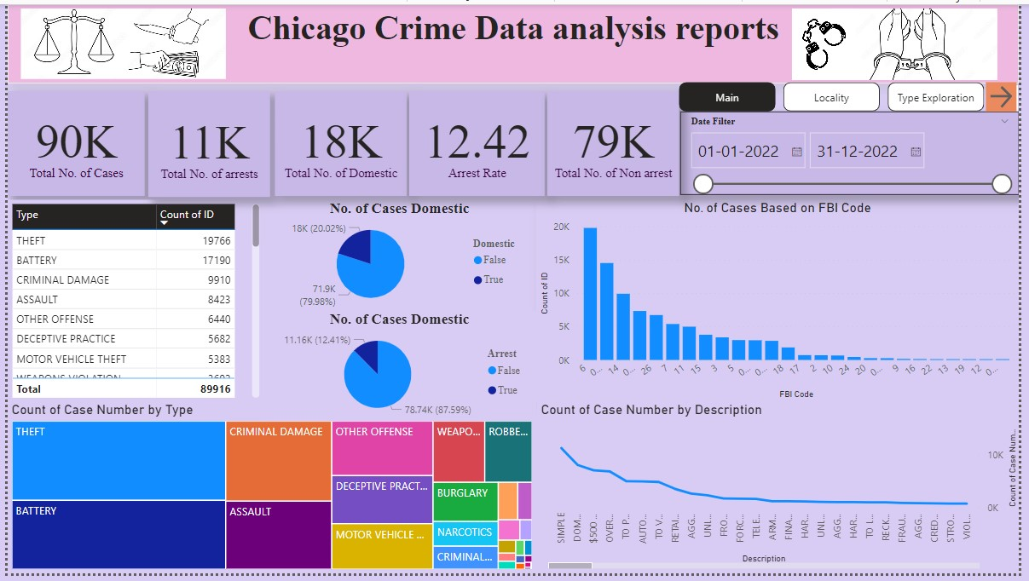

Slide 12
Crimes in view of FBI code and Case description:
Simple cases: Highest count at 11244 incidents reported.
Domestic battery: Second highest count at 8060 documented cases.
Theft: $500 and under, with 7024 reported incidents.
Property damage: Over $500, totaling 6813 cases recorded.
Specific crimes: Automobile, vehicle, retail theft, handgun-related offenses prevalent.
FBI Code 6: Most reported, with 19766 cases documented.
Code 08B: Second highest count, totaling 14508 reported incidents.

Slide 13
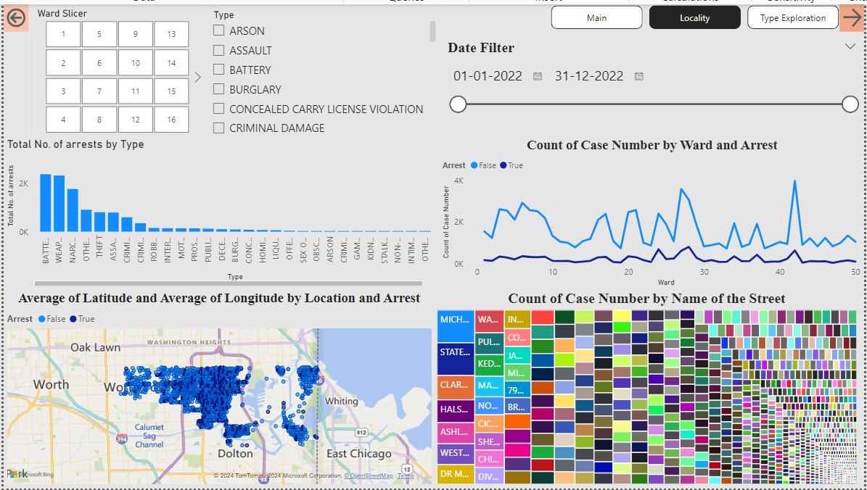

Slide 14
Locality Page:
Locality page includes slicers for ward, type, and date.
Enhanced functionality, Enables filtering data by specific parameters easily.
Map view created, Shows case distribution, with legends for arrests.
Enhanced visualization, Distinguishes between arrested and non-arrested cases effectively.
Tree Map generated, Visualizes case occurrence based on street names.
Enhanced understanding: Street-wise distribution of reported cases illustrated effectively.

Slide 15
Ward Vs Arrest:
Line chart displays ward-wise trends for arrested and non-arrested cases.
Clear graphical representation: Easily discerns fluctuations and patterns across different wards.
Enhanced analysis: Facilitates comparison and understanding of law enforcement outcomes in each ward.

Slide 16
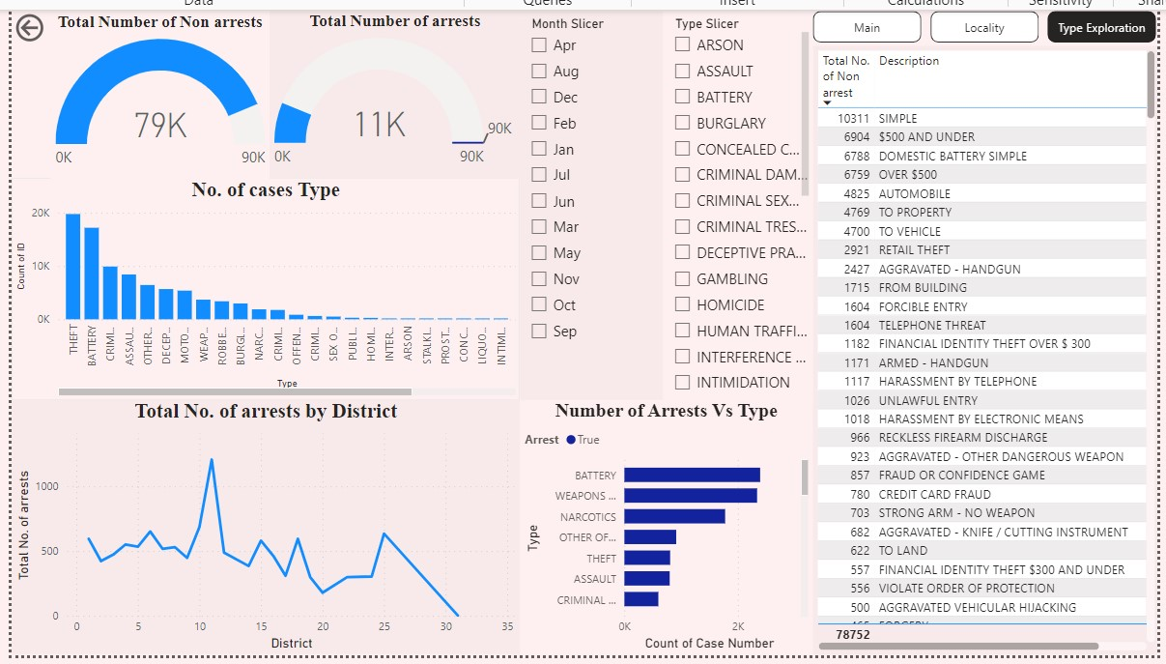

Slide 17

Type of Exploration Page:
Exploration page includes slicers for month and type.
It includes graphical representation on districts according to the arrests.
Based on the type of crime how many were arrested given in the visualizations.

Slide 18
Conclusion
Chicago's crime report underscores the urgency to bolster police manpower, particularly targeting areas with high incident rates based on crime types and localities.
Data-driven insights and visualizations highlight specific crime patterns, guiding resource allocation for a more efficient and targeted law enforcement approach.
Increasing police presence in these identified hotspots is paramount to deterrence and prompt response, fostering community safety and trust.
Collaboration between law enforcement agencies, policymakers, and community stakeholders is essential to implement proactive strategies aimed at crime reduction.
Continuous monitoring and adaptation of tactics based on ongoing analysis of crime trends will be critical for sustained improvement in Chicago's security landscape.

Slide 19


